Slide 1
Data Project
Null Hypothesis (H0): "There is no statistically significant correlation between the daily stock returns of Apple, Tesla, and Microsoft and the S&P 500."
Alternative Hypothesis (H1): "There is a statistically significant positive correlation between the daily stock returns of Apple, Tesla, and Microsoft and the S&P 500.
Hypothesis: There exists a statistically significant correlation between the daily stock returns of Apple (AAPL), Tesla (TSLA), and Microsoft (MSFT) and the overall performance of the stock market represented by the S&P 500 index. Specifically, we hypothesize that the returns of these individual stocks are positively correlated with the returns of the S&P 500, indicating that the overall market performance influences the stock prices of these major technology companies.
Hamza SOYUER

Slide 2
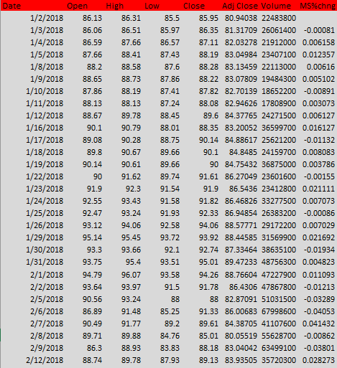
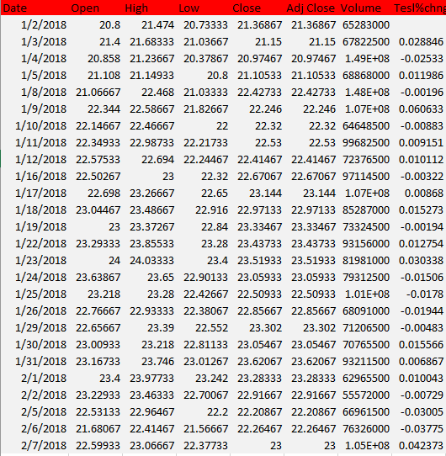
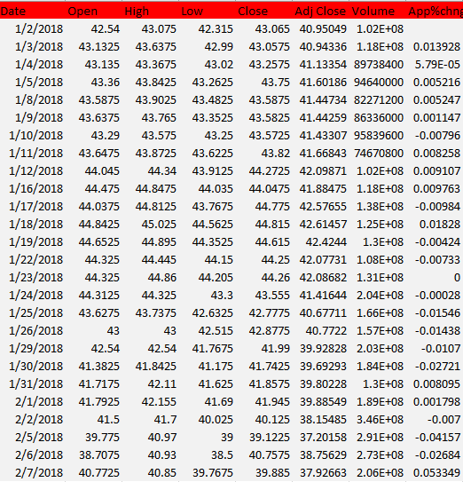
Here are stock values of three companies which are Microsoft, Tesla and Apple.
MICROSOFT
TESLA
APPLE

Slide 3
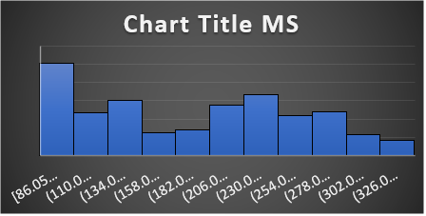
Descriptive Statistics (Microsoft)
The given charts illustrates the stock values of Microsoft company over the years. There has been an upward trend in the stock values of Microsoft between 2018 and 2021. However, in 2021, a notable inflection point occurred, marked by a decline from its peak value of 350. Subsequently, the stock values have exhibited a fluctuating pattern, characterized by both decreases and increases. Currently, the stock values persist around 250, reflecting a dynamic interplay of market forces, with the stock experiencing oscillations in recent times.

Slide 4
Measures of central currency and T test (Microsoft)
Open MS
Mean | 194.4709
Standard Error | 2.076481
Median | 203.58
Mode | 95.14
Standard Deviation | 74.2324
Sample Variance | 5510.449
Kurtosis | -1.28796
Skewness | 0.149832
Range | 258.56
Minimum | 86.06
Maximum | 344.62
Sum | 248533.8
Count | 1278
Largest(1) | 344.62
Smallest(1) | 86.06
Confidence Level(95.0%) | 4.07369
 | MSFT | SP500
Mean | 194.4709 | 3457.034
Variance | 5510.449 | 444300.9
Observations | 1278 | 1278
Pooled Variance | 224905.7
Hypothesized Mean Difference | 0
df | 2554
t Stat | -173.904
P(T<=t) one-tail | 0
t Critical one-tail | 1.64545
P(T<=t) two-tail | 0
t Critical two-tail | 1.960893
It is obvious that histogram shows an skewed distribution of stock values over the years. In statistics Median has been used for skewed distribution to comment about Data. Given these statistics:
The median being greater than the mean suggests a negatively skewed distribution.
The presence of a mode at 95 indicates that there is a peak in the distribution around this value.
Therefore, based on the information provided, the distribution is likely negatively skewed with a mode around 95. This implies that there is a tail on the right side of the distribution (toward higher values), and the majority of values are concentrated on the left side. In addition if p value less than Alpha(0.05), that means to reject the null hypothesis.

Slide 5
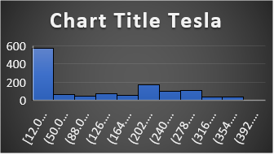
Descriptive Statistics (Tesla)
The dataset representing Tesla stock values between 2018 and 2023 reveals key characteristics of the stock's distribution. The mean (average) stock value stands at approximately 131.90, indicating the central tendency of the data. The dataset exhibits considerable variability, as reflected in the high standard deviation of approximately 117.17 and a wide range spanning from a minimum of 12.07 to a maximum of 411.47. The positive skewness of approximately 0.47 suggests a distribution with a longer right tail, indicating that there are instances of higher stock values. The mode, centered at 24, signifies a concentration of stock values around this point, potentially indicating a consistent and frequent occurrence of this particular value. In summary, the Tesla stock values dataset exhibits notable variability, a right-skewed distribution, and a mode that suggests a distinct point of concentration within the observed values over the specified time period.

Slide 6
Measures of central currency and T test (Tesla)
-The mean being greater than the median suggests that the dataset is positively skewed. The presence of a mode at 24 further supports this indication of positive skewness.
The median being less than the mean suggests that there are relatively lower values that are pulling the mean upward.
The mode being at 24 suggests that 24 is the most frequent value in the dataset.
When the t-test has been considered, A p-value of 0 (or p < 0.001) is considered extremely statistically significant. It indicates strong evidence against the null hypothesis.
Open
Mean | 131.8952
Standard Error | 3.277467
Median | 96.57333
Mode | 24
Standard Deviation | 117.1666
Sample Variance | 13728.01
Kurtosis | -1.25726
Skewness | 0.470592
Range | 399.3967
Minimum | 12.07333
Maximum | 411.47
Sum | 168562.1
Count | 1278
Largest(1) | 411.47
Smallest(1) | 12.07333
Confidence Level(95.0%) | 6.429811
t-Test: Two-Sample Assuming Equal Variances
 | SP500 | Tesla
Mean | 3457.034 | 131.8952
Variance | 444300.9 | 13728.01
Observations | 1278 | 1278
Pooled Variance | 229014.5
Hypothesized Mean Difference | 0
df | 2554
t Stat | 175.6422
P(T<=t) one-tail | 0
t Critical one-tail | 1.64545
P(T<=t) two-tail | 0
t Critical two-tail | 1.960893

Slide 7
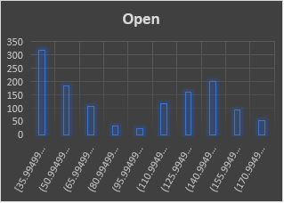
Descriptive Statistics (Apple)
The given charts illustrates the stock values of Microsoft company over the years. There has been an upward trend in the stock values of Microsoft between 2018 and 2021. However, in 2021, a notable inflection point occurred, marked by a decline from its peak value of 350. Subsequently, the stock values have exhibited a fluctuating pattern, characterized by both decreases and increases. Currently, the stock values persist around 250, reflecting a dynamic interplay of market forces, with the stock experiencing oscillations in recent times.

Slide 8
Measures of central currency and T test (Apple)
The dataset exhibits a moderate spread, as indicated by the standard deviation and range.
The positive skewness and negative kurtosis suggest a distribution with a longer right tail and lighter tails than a normal distribution, respectively.
The mode being at 127.82 indicates a concentration of data around this value.
Open Apple
Mean | 98.5741
Standard Error | 1.291672
Median | 95.0875
Mode | 127.82
Standard Deviation | 46.17614
Sample Variance | 2132.236
Kurtosis | -1.58204
Skewness | 0.121834
Range | 146.635
Minimum | 35.995
Maximum | 182.63
Sum | 125977.7
Count | 1278
Largest(1) | 182.63
Smallest(1) | 35.995
Confidence Level(95.0%) | 2.534032
t-Test: Two-Sample Assuming Equal Variances
 | Open | SP500
Mean | 98.5741 | 3457.034
Variance | 2132.236 | 444300.9
Observations | 1278 | 1278
Pooled Variance | 223216.6
Hypothesized Mean Difference | 0
df | 2554
t Stat | -179.691
P(T<=t) one-tail | 0
t Critical one-tail | 1.64545
P(T<=t) two-tail | 0
t Critical two-tail | 1.960893

Slide 9

Hypothesis Evaluation
The null hypothesis (H0) posits that there is no statistically significant correlation between the daily stock returns of Apple, Tesla, and Microsoft and the S&P 500, suggesting that fluctuations in these individual stocks are not systematically related to the movements of the broader market. On the contrary, the alternative hypothesis (H1) asserts that there is a statistically significant positive correlation between the daily stock returns of these companies and the S&P 500, implying that the stock returns tend to move in tandem with the overall market trends. To test these hypotheses, a statistical analysis, such as a correlation coefficient or regression analysis, can be employed on historical stock return data. If the analysis reveals a significant positive correlation, it would provide evidence supporting the alternative hypothesis, suggesting that the stock returns of Apple, Tesla, and Microsoft are influenced by the movements in the S&P 500. Conversely, if the analysis does not find a significant correlation, it would lend support to the null hypothesis, indicating that the daily stock returns of these companies and the S&P 500 are not statistically linked.

Slide 10
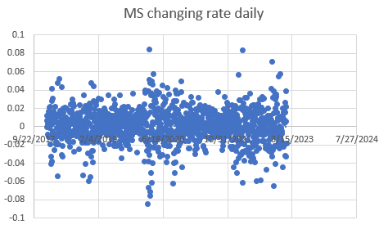
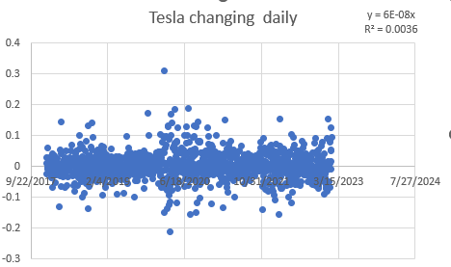
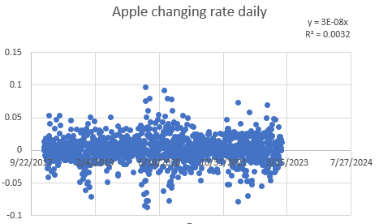
Regression Analysis
A higher Beta generally implies higher risk and potential for higher returns. Investors with a higher risk tolerance may find stocks with higher Beta appealing.
R-squared measures how well the stock's performance can be explained by market movements. A lower R-squared suggests that other factors beyond the market significantly influence the stock's performance.
 | MS | TESLA | APPLE
Beta | 1.223216 | 1.836604 | 1.33991
R square | 0.604511 | 0.232445 | 0.549611

Slide 11
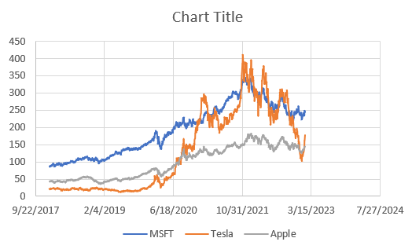
Overall
Investors should consider these values along with their risk tolerance and investment goals when making decisions. High Beta stocks can lead to higher returns, but they come with increased volatility and potential for larger losses. It's crucial for investors to diversify their portfolios and conduct thorough research.

